Slide 1
CS 331
More about Classes and Inheritance
MD Romael Haque

Slide 2
Overloading the Stream Insertion and Extraction Operators
Overloading the stream insertion operator << is convenient because it allows values of objects to be converted into text and output to cout, to a file object, or to any object of a class that derives from ostream.

Slide 3


Overloading the Stream Insertion and Extraction Operators
In the presence of appropriate overloads, the statements
appear to the compiler as

Slide 4
Overloading the Stream Insertion and Extraction Operators
This equivalence has the following implications:
The overloaded operator << takes two parameters, the first of which is an ostream object and the second of which is an object of the class for which the operator is being overloaded. For the Length class, the prototype would be operator<<(ostream &strm, Length a)
To allow expressions (such as b + c) in the second parameter, the second parameter should be passed by value. The first parameter should be passed by reference because ostream parameters should never be passed by value because of efficiency and preservation.

Slide 5

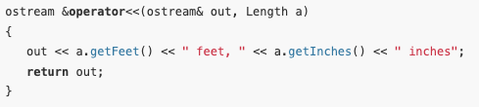
Overloading the Stream Insertion and Extraction Operators
In addition, the stream insertion operator should return its stream parameter so that several output expressions can be chained together, as in –
Putting all of this together, we see that the stream insertion operator should be written as

Slide 6
Overloading the Stream Insertion and Extraction Operators
Overloading the stream output operator is useful because it allows for the various fields of a complex class to be labeled during output.
For example, if you have a complex class with multiple fields, such as a Person class with fields for name, age, and address, overloading << lets you specify how each field should be displayed, including adding labels.
std::cout << person; // where person is an object of class Person
By overloading the << operator, the output might appear as:
Name: John Doe, Age: 30, Address: 123 Main St

Slide 7
Overloading the Stream Insertion and Extraction Operators
Overloading the stream input operator is similar, except that the class parameter signifying the object to be read into must be passed by reference. Thus, the header for the stream input operator looks like this:
istream &operator>>(istream &in, Length &a);

Slide 8
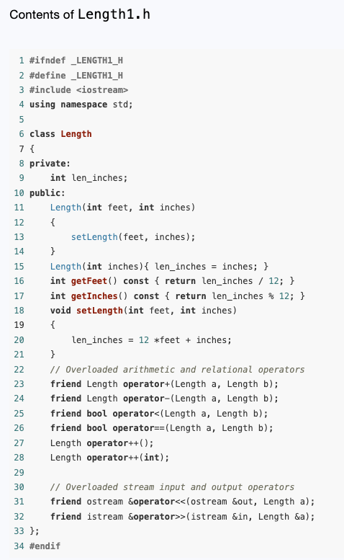
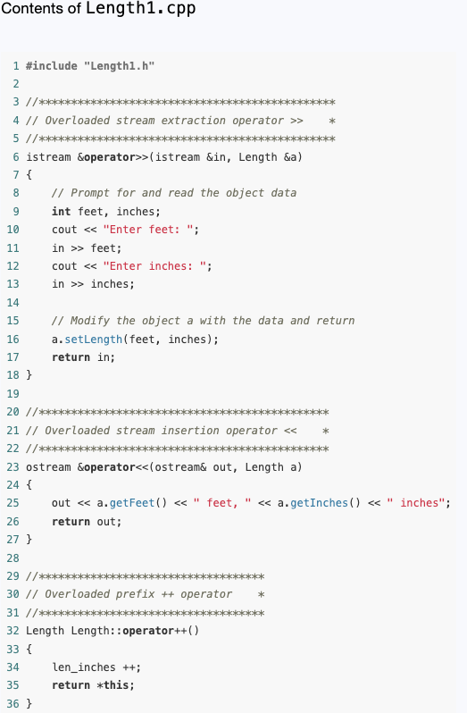
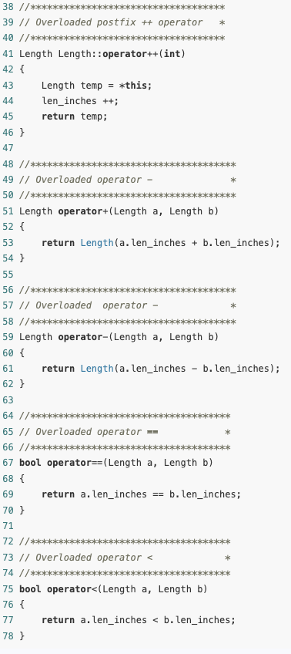

Slide 9
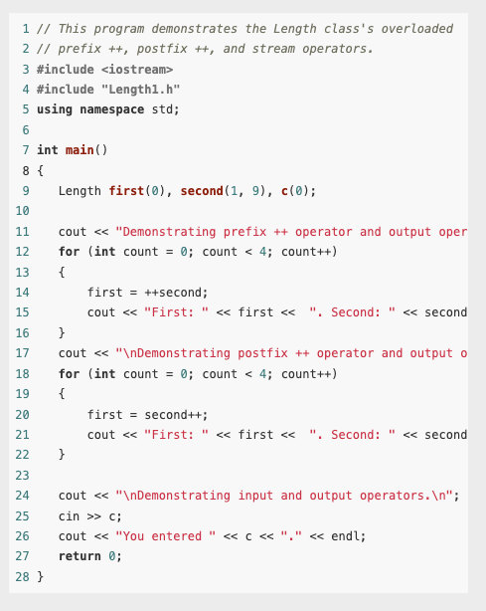
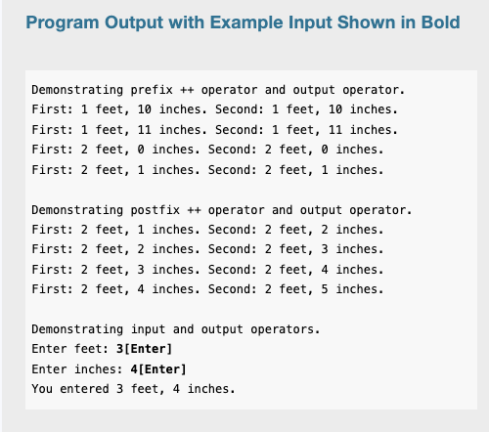

Slide 10
Overloading the [] Operator
Any C++ class can overload the array indexing operator [ ] to make its objects have array-like behavior.
To give a simple example, suppose we want to write a Name class to represent the full name of a person. For such a name object, we want name[1] to be the first name and name[2] to be the last name.
Furthermore, we want an attempt to index such an object with any integer other than 1 and 2 to terminate the program with an error message.

Slide 11
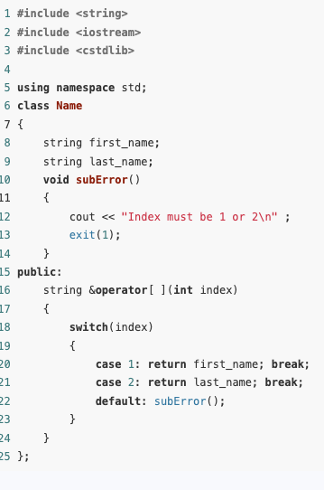
Example
Notice that the operator [ ] function takes an int parameter and returns a reference to a string variable.
If name is an object of this class and k is an integer, the call name.operator[ ](k) will be equivalent to name[k].
Basically, name[1] will return a reference to the member variable first_name, and name[2] will return a reference to last_name.

Slide 12
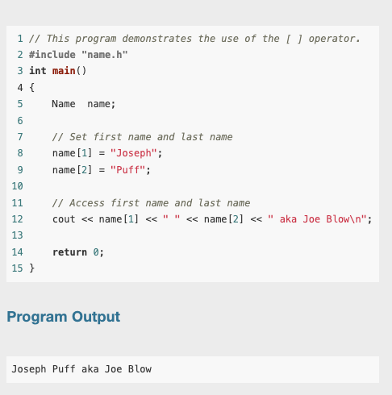
Example

Slide 13
Classes as a custom data type
In C++, operator functions or operator overloading allow you to define or "overload" standard operators (like +, -, ==, etc.) for custom classes, so that objects of your classes can interact in ways similar to built-in data types (like int, double, etc.).
When you overload operators, you're essentially customizing how operations work on your class objects. This makes using your classes more intuitive and expressive.

Slide 14
Type Conversion Operators
Special operator functions may be written to convert a class object to any other type.
Usually, data type conversion happens “behind the scenes” with the built-in data types.

Slide 15
Type Conversion Operators
For instance, suppose a program uses the following variables:
int i;
double d;
The following statement automatically converts the value in i to a double and stores it in d:
d = i;
Likewise, the following statement converts the value in d to an integer (truncating the fractional part) and stores it in i:
i = d;

Slide 16
Type Conversion Operators
The same functionality can also be given to class objects.
For example, assuming distance is a Length object and d is a double.
The following statement would conveniently store distance into a floating-point number stored in d, if Length is properly written:
d = distance;

Slide 17

Type Conversion Operators
To be able to use a statement such as this, an operator function must be written to perform the conversion.
Here is an operator function for converting a Length object to a double:
No return type is specified in the function header because the return type is inferred from the name of the operator function.
Also, because the function is a member function, it operates on the calling object and requires no other parameters.

Slide 18
Convert Constructors
A constructor that takes a single parameter of a type other than its class type can be regarded as converting its parameter into an object of its class.
Such a constructor is called a convert constructor.
In addition to the function of creating objects of its class, a convert constructor provides the compiler with a way of performing implicit type conversions.
Such type conversions will be performed by the compiler whenever a value of the constructor’s parameter type is given where a value of the class type is expected.

Slide 19
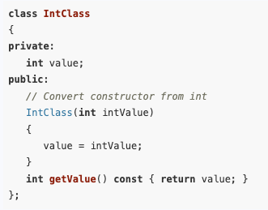
Convert Constructors
In C++, a conversion constructor is a constructor that can be called with a single argument and is used to convert that argument's type to the type of the class.
In this code, the IntClass(int intValue) constructor is a conversion constructor because:
It takes a single argument of type int.
This argument type (int) is different from the class type (IntClass).
This means that if we have an int value, the compiler can automatically convert that int to an IntClass object by calling this constructor.
As a simple example, consider the class

Slide 20
Convert Constructors
Convert constructors are automatically invoked by the compiler whenever the context demands a class object but a value of constructor’s parameter type is provided.
This occurs in four different contexts:
An object of the class is initialized with a value of the convert constructor’s parameter type. For example,
IntClass intObject = 23;
2. An object of the class is assigned a value of the convert constructor’s parameter type. For example,
IntObject = 24;

Slide 21

Convert Constructors
3. A function expecting a value parameter of the class type is instead passed a value of the constructor’s parameter type. For example, we may define a function –
and then pass it an int when we call it: printValue(25);
The compiler will use the convert constructor to convert the integer 25 into an object of the IntClass class and will then pass the object to the function.

Slide 22
Convert Constructors
The compiler will not invoke the convert constructor if the formal parameter is a pointer or a reference to an IntClass object.
This is because pointers and references expect an already-existing object, not an implicit conversion.
Convert constructors are only invoked when the formal parameter uses pass by value.
It’s essentially making a copy of IntClass as an object. In this case, if an integer is passed by value to the function, the compiler will invoke the conversion constructor to create an IntClass object from the integer and pass it to the function.

Slide 23
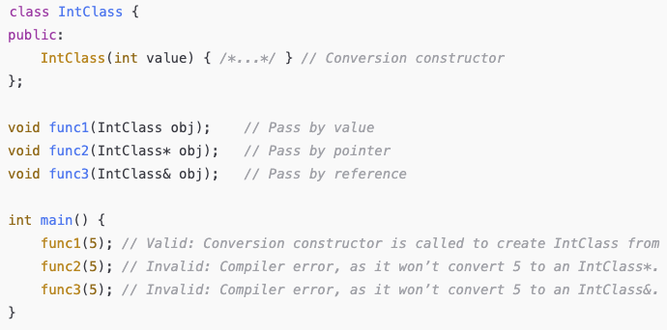
Example

Slide 24

Convert Constructors
4. A function that declares a return value of the class type actually returns a value of the convert constructor’s parameter type.
For example, the compiler will accept the following function:
Note that the function returns a value of type integer, even though IntClass is declared as its return type.
Again, the compiler will implicitly call the convert constructor to convert the integer intValue to an IntClass object.
It is this object that is returned from the function.

Slide 25
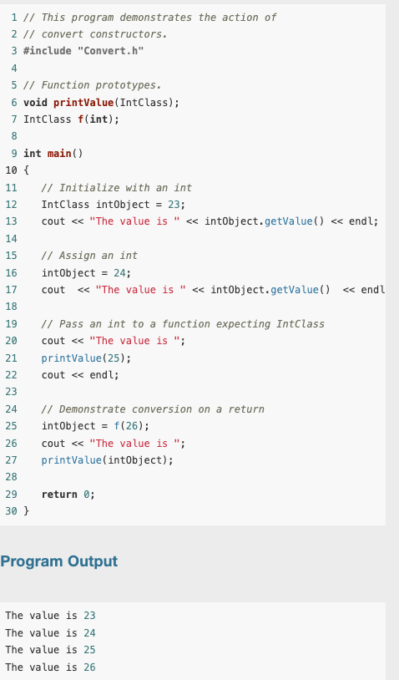
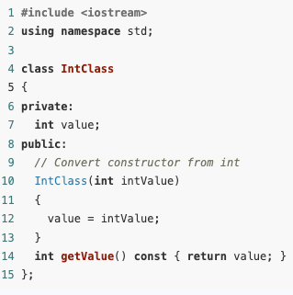
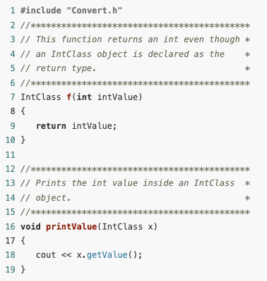
Example

Slide 26
Aggregation and Composition
Class aggregation occurs when an object of one class owns an object of another class.
Class composition is a form of aggregation where the owner class controls the lifetime of objects of the owned class.

Slide 27
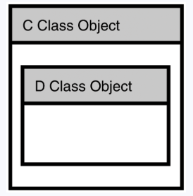
Aggregation and Composition
When a class (let's say C) contains a member that is an object of another class (D), we say that C "has a" D object.
This means that each instance of C will include its own instance of D as part of its internal structure.
This relationship is often called a has-a relationship
In this type of relationship, every instance of C has, or owns, an instance of the class D

Slide 28
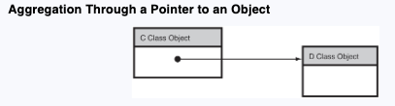
Aggregation and Composition
In C++, such ownership usually occurs as a result of having a member of type , but it can also occur as a result of having a pointer to an object of D
The term aggregation is often broadly used to describe situations in which objects of one class own objects of other classes.

Slide 29
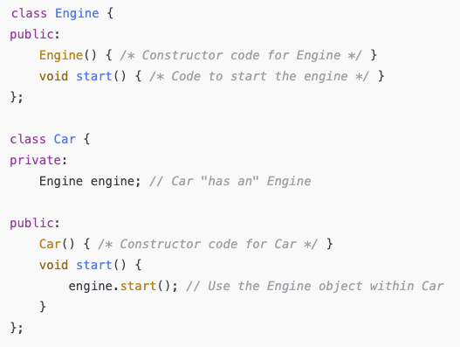
Aggregation and Composition
Imagine we have two classes, Car and Engine.
A Car has an Engine, so you would include an Engine object as a member within the Car class.
This forms a has-a relationship, meaning every Car object includes and "owns" its own Engine object.

Slide 30
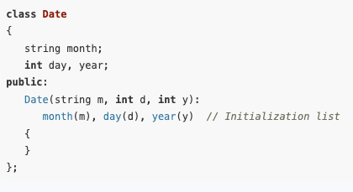
Member Initialization Lists with Aggregation
We learned that one of the ways to initialize class members is by using an initialization list with the constructor

Slide 31
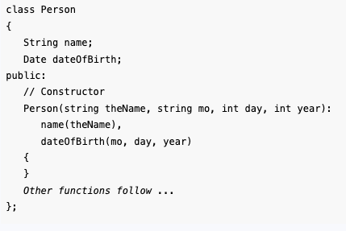
Member Initialization Lists with Aggregation
To see how a member initialization list can be used when one class owns an object of another class, here is part of the definition of a Person class that owns an instance of the Date class.

Slide 32
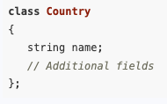
Aggregation Through Pointers
Now let’s suppose that, in addition to having a date of birth, each person has a country of residence.
A country has a name and possibly many other attributes:

Slide 33
Aggregation Through Pointers
Because many people will “have” the same country, the has-a relationship between Person and Country should not be implemented by embedding an instance of the Country class inside every Person object.
Because many people share the same country of residence, implementing the has-a relation by containment will result in unnecessary duplication of data and waste memory.
In addition, it would require many Person objects to be updated whenever a country has a change in any of its data.
Using a pointer to implement the has-a relation avoids these problems.

Slide 34
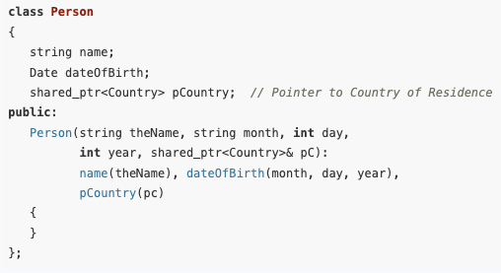
Aggregation Through Pointers
Here is a version of the Person class, modified to include a pointer to the country of residence:

Slide 35
Aggregation, Composition, and Object Lifetimes
Composition is a term used to describe special cases of aggregation in which the lifetime of the owned object coincides with the lifetime of its owner.
A good example of composition is when a class C contains a member that is an object of another class D.
The contained D object is created at the same time that the C object is created and is destroyed when the containing C object is destroyed or goes out of scope.
Another example of composition is when a class C contains a pointer to a D object and the D object is created by the C constructor and destroyed by the C destructor.

Slide 36
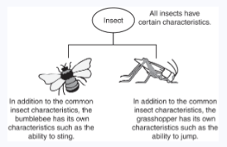
Inheritance: Generalization and Specialization
In the real world, you can find many objects that are specialized versions of other objects.
For example, the term “insect” describes a very general type of creature with numerous characteristics.
Because grasshoppers and bumblebees are insects, they have all the general characteristics of an insect.
In addition, they have special characteristics of their own.
For example, the grasshopper has its jumping ability, and the bumblebee has its stinger. Grasshoppers and bumblebees are specialized versions of an insect.

Slide 37
Inheritance and the Is-a Relationship
When one object is a specialized version of another object, there is an is-a relationship between them.
For example, a grasshopper is an insect.
When an is-a relationship exists between objects, it means that the specialized object has all of the characteristics of the general object, as well as additional characteristics that make it special.
In object-oriented programming, inheritance is used to create an is-a relationship between classes.

Slide 38
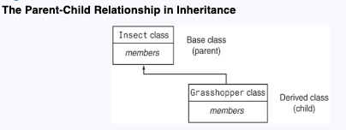
Inheritance and the Is-a Relationship
Inheritance involves a base class and a derived class.
The base class is the general class, and the derived class is the specialized class.
The derived class is based on, or derived from, the base class.
We can think of the base class as the parent and the derived class as the child.

Slide 39
Inheritance and the Is-a Relationship
The derived class inherits the member variables and member functions of the base class without any of them being rewritten.
Furthermore, new member variables and functions may be added to the derived class to make it more specialized than the base class.

Slide 40
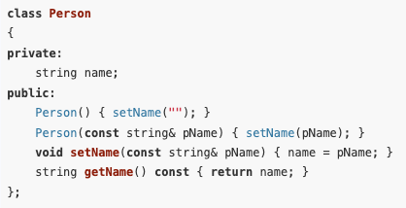
Inheritance and the Is-a Relationship
To take a specific example, consider a college or university environment where there are both students and faculty personnel.
Suppose that we have a class Person with a name data member and member functions for working with the name member

Slide 41
Inheritance and the Is-a Relationship
Suppose further that we have the enumerated types
To define the range of disciplines in which studies are offered and the classification of students.
We can use these types to define Student and Faculty classes that inherit from Person.
This makes sense because a Student is a Person and a Faculty member is also a Person.

Slide 42
Inheritance and the Is-a Relationship
To define a class by inheritance, we need to specify the base class plus the additional members the derived class adds to the base class.
Let’s say that in addition to having all the characteristics of a Person, a Student must declare a major in some discipline and have an academic advisor who is a Person.

Slide 43
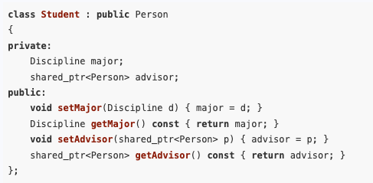
Inheritance and the Is-a Relationship
The Student class can be defined as follows:
We assume that many different students may have the same advisor.
The Student object stores a shared smart pointer to the advisor to avoid memory management problems.

Slide 44

Inheritance and the Is-a Relationship
The first part of the first line of the class declaration specifies Student as the name of the class being defined and specifies the existing class Person as its base class.
The key word public that precedes the name of the base class is the base class access specification.
It affects how the members of the base class will be accessed by the member functions of the derived class and by code outside of the two classes.

Slide 45
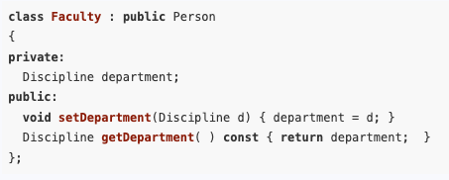
Inheritance and the Is-a Relationship
A class can be used as the base class for more than one derived class.
A Faculty class can also be derived from the Person class as follows:
Thus, a Faculty object is a Person object that has a home department in some discipline.

Slide 46
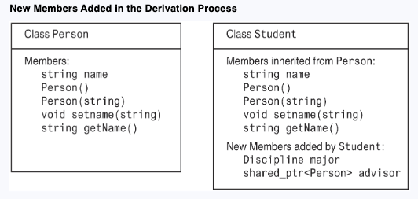
Inheritance and the Is-a Relationship
It is also important to note that each object of the derived class will contain all members of the base class.

Slide 47
Inheritance and Pointers
Whenever inheritance is involved, all objects should be dynamically allocated and accessed through pointers.
To see why, consider a program that works with both Student and Person types.
Because a Student is a Person, we should be able to pass Student objects to functions that expect a parameter of type Person or assign a Student object to a variable of type Person.
Person p;
Student s;
p = s;

Slide 48
Inheritance and Pointers
However, a Student object, with its additional members, will not fit in a memory location allocated for a Person object.
To carry out such an assignment, the compiler will slice off the Student parts that do not belong to Person, leaving only the inherited parts and resulting in loss of information.
This does not occur if we are dealing with pointers because all pointers have the same size.

Slide 49
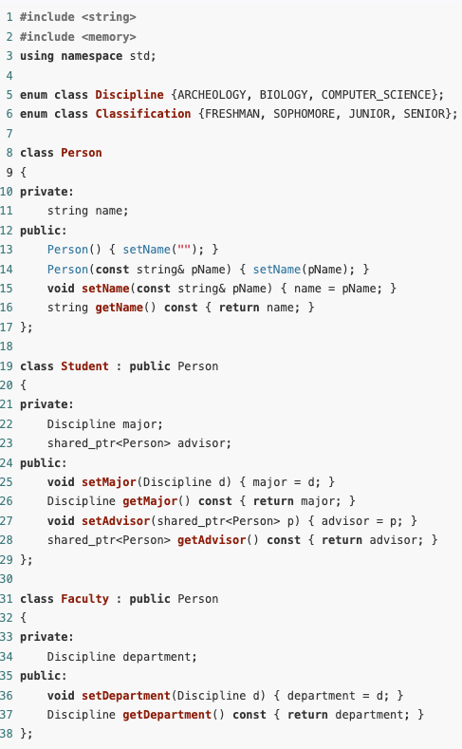
Inheritance and Pointers
This example demonstrates the creation and use of an object of a derived class by creating a Faculty object.
The program uses arrays of strings that map values of enumerated types to strings to enable printing of values of enumerated types in the form of strings.
The included “inheritance.h” file contains declarations of the Person, Student, and Faculty classes, as well as the enumerated types Discipline and Classification.

Slide 50
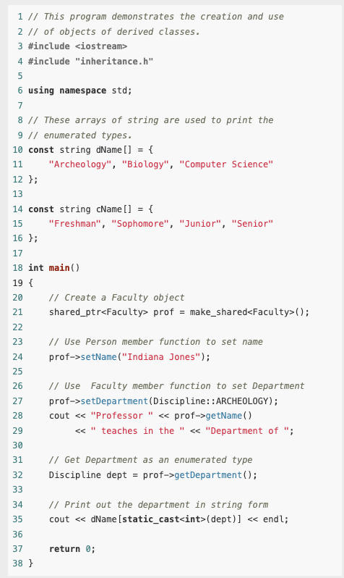

Inheritance and Pointers

Slide 51
Superclasses and Subclasses
We can think of a class as describing the set of all objects that have certain characteristics.
An object of a derived class inherits all the characteristics of the base class, so it can be regarded as belonging to the base class.
Thus, objects of the derived class are just specialized objects of the base class.
For this reason, the derived class is often called a subclass of the base class, and the base class is called a superclass of the derived class.

Slide 52
Multiple Inheritance
C++ supports multiple inheritance in which a derived class simultaneously derives from two or more base classes.
Though interesting, multiple inheritance can lead to programs that are very difficult to understand and is rarely useful in practice.
We will not go through that in this semester.

